Slide 1
Project Deliberative #2
Team Members:
Daniel David, Zhangjing Cheng, Cooper Orio, Yuxuan Chen
Project: Predicting Sleep Health & Lifestyle Patterns
Analyze lifestyle and physiological factors influencing sleep quality.
Dataset: Sleep Health and Lifestyle from Kaggle: https://www.kaggle.com/datasets/uom190346a/sleep-health-and-lifestyle-dataset

Slide 2
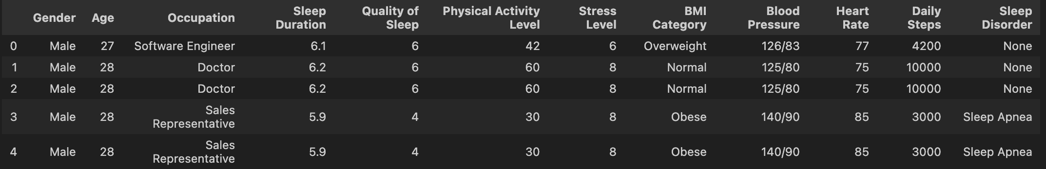
Handling Duplicates & Initial Data Exploration
Handling Duplicates:
We removed duplicates to prevent data leakage and minimize overfitting. The sample size was reduced by 65%, from 374 to 132 records. Since the dataset is synthetic, removing duplicates may have altered the original distribution.
Future Comparison Plan → To assess the impact of deduplication, we will compare results from both deduplicated and non-deduplicated datasets in the final deliverable.
Initial Data Exploration:
Synthetic dataset with 13 features and 374 records.
Data Cleaning: Handled missing values by filling Sleep Disorder as 'None'. Removed duplicates reducing dataset size. Dropped irrelevant columns (Person ID).
Class Consolidation: Quality of Sleep (the target variable) was grouped into three categories – Poor (4&5), Moderate (6&7), Good (8&9). -Nominal variables- This transformation converted the task into a three-class classification problem, streamlining the modeling process and improving class balance.
Example of the dataset:

Slide 3
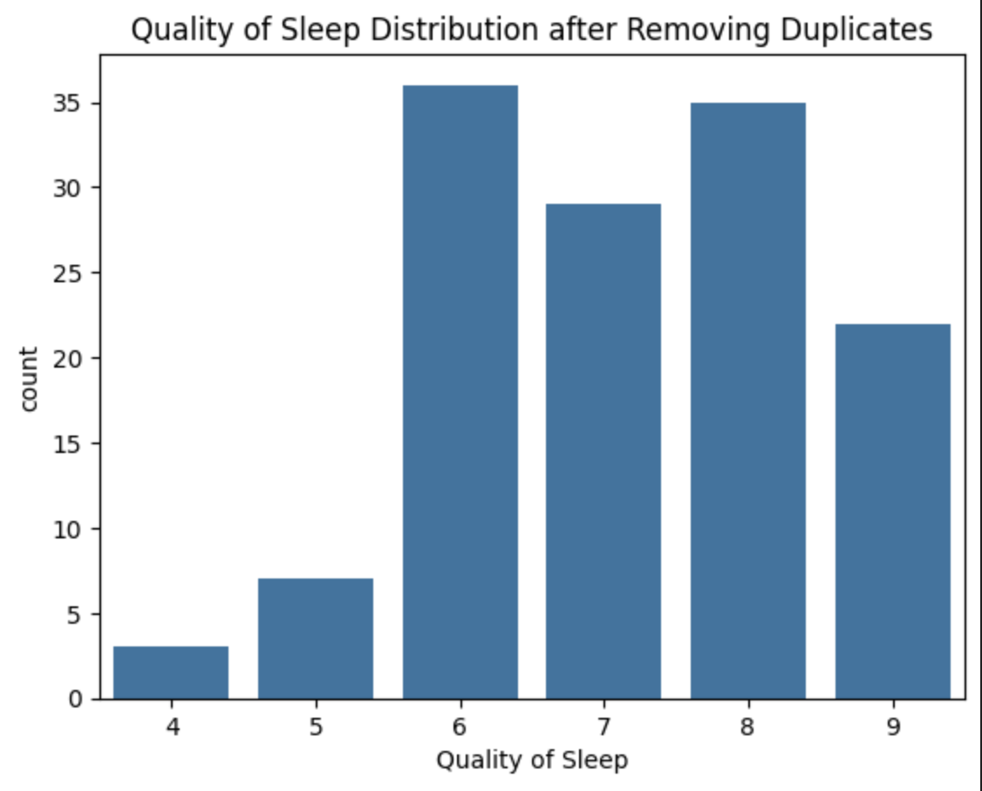
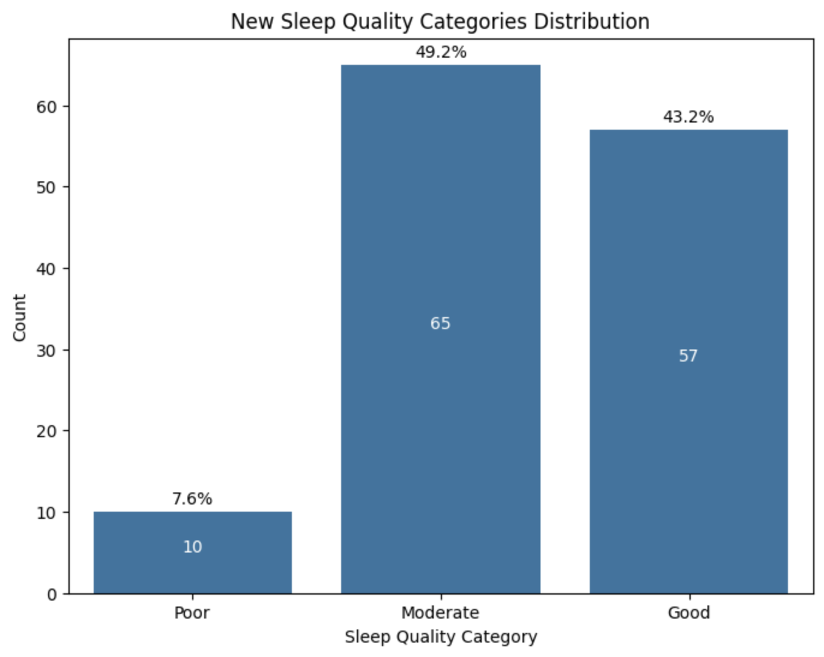

Sleep Quality Distribution
Created simplified categories due to small dataset size. Defining that Good: >= 8, Moderate: >=5, Poor: <5
Distribution: Good (57 times), Moderate (65 times), Poor (10 times).
Addressed class imbalance with SMOTE during modeling.
$$→$$

Slide 4
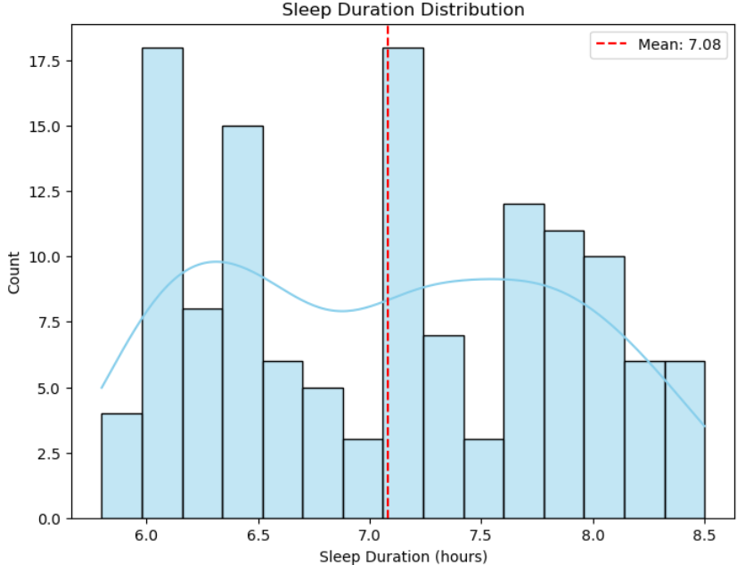
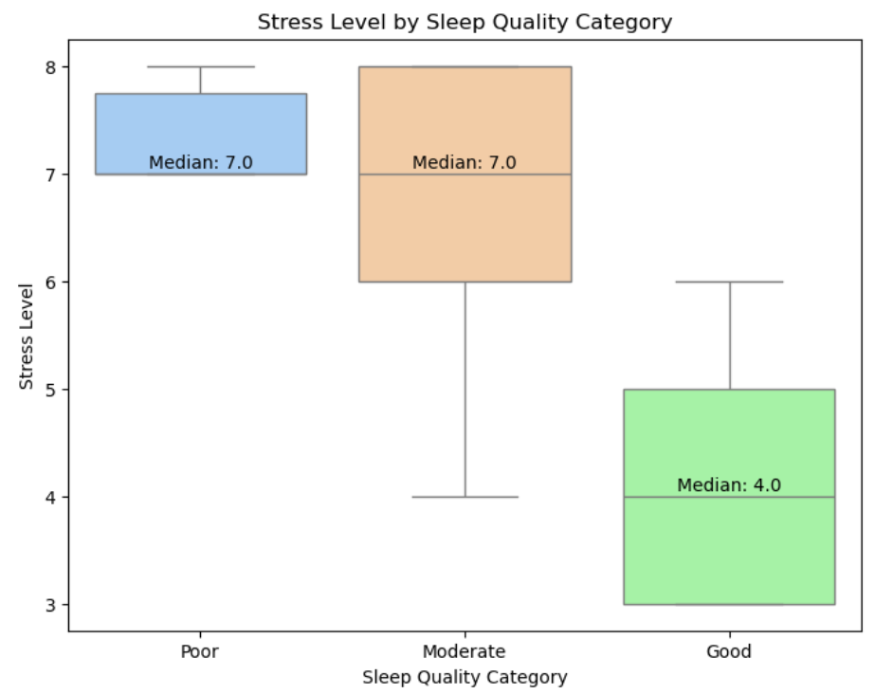
Feature Engineering & Univariate Analysis
Split the Blood Pressure feature into Systolic_BP and Diastolic_BP to better analyze the influence of blood pressure on sleep quality.
Univariate Analysis:
We conducted univariate analyses to explore the distribution of individual features and their relationship with the newly created Sleep Quality Category.
Some Key findings: ① The majority of individuals reported sleep durations between 6.5 and 8 hours, aligning with the recommended sleep range. Individuals with lower sleep duration tended to fall into the Poor category. ② Stress Level followed a skewed distribution. The median stress level was higher in Poor and Moderate categories compared to Good.

Slide 5
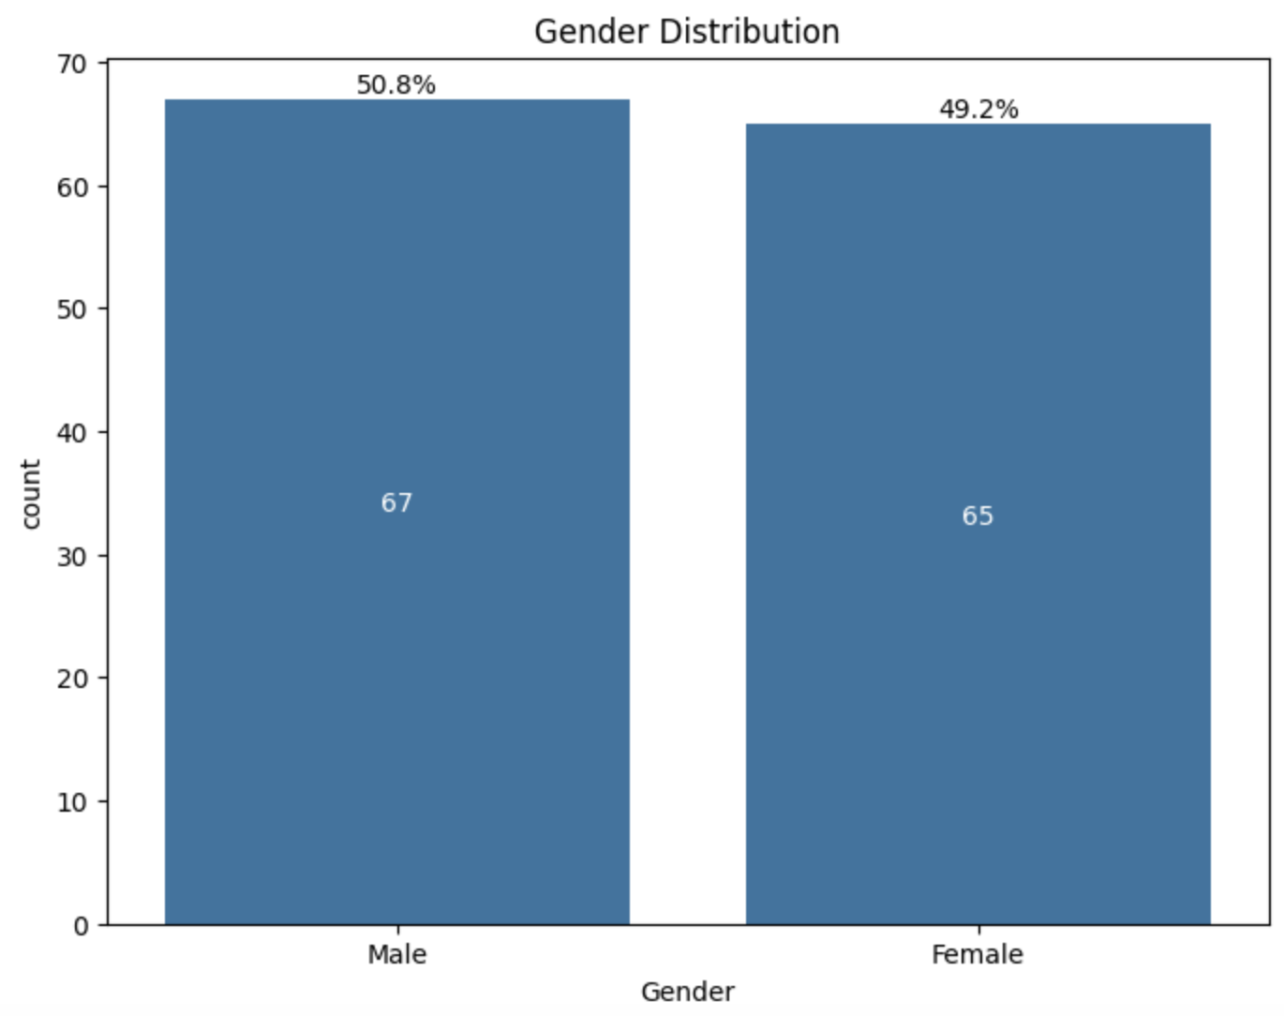
Influence of Gender & Age
Gender Distribution: Slightly balanced (Male & Female).
Age vs. Sleep Quality: Older age correlates with better sleep.
Gender vs. Sleep Quality: Minor gender differences observed.

Slide 6
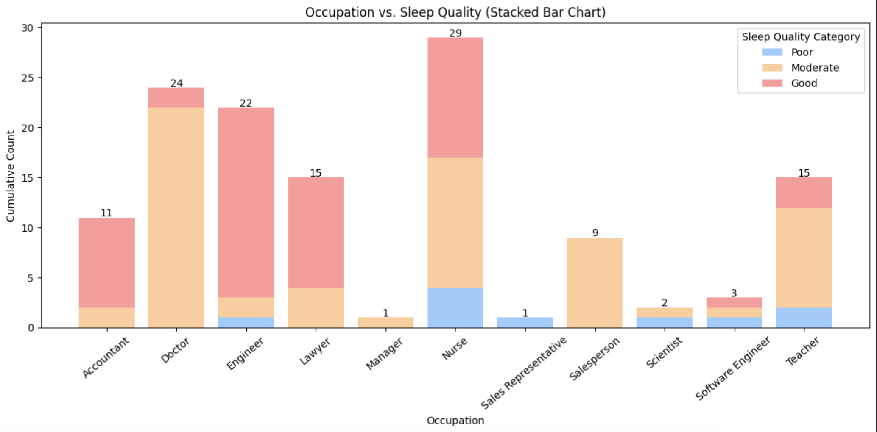
Occupation & Lifestyle Insights
Occupation significantly correlated with sleep quality.
Doctors showed distinct patterns in sleep quality.
Physical activity, stress level, and daily steps notably influence sleep.

Slide 7
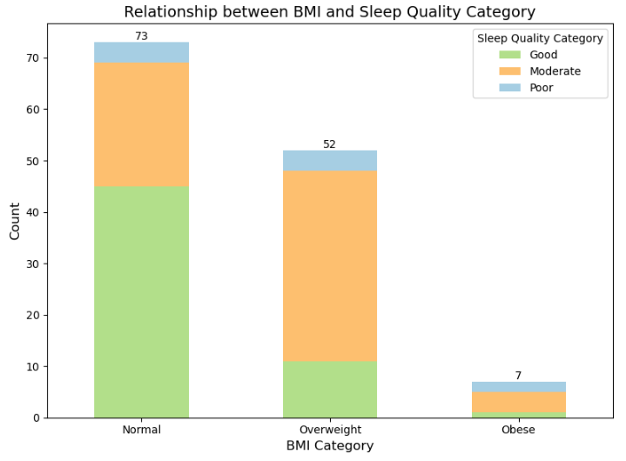
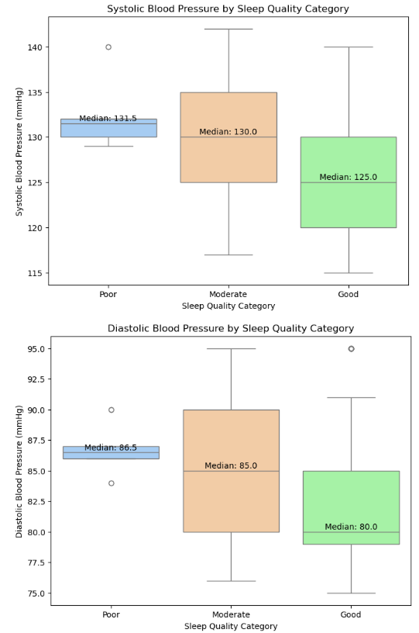
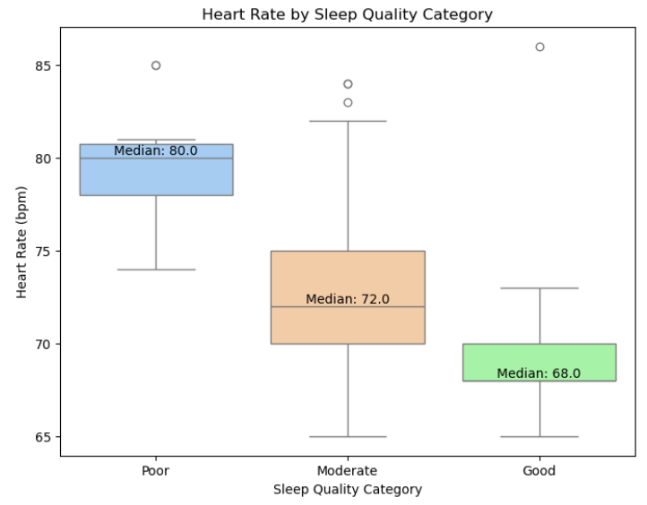
Health Metrics Impact
BMI Categories (Normal, Overweight, Obese) impact sleep.
Blood Pressure (Systolic & Diastolic) correlates moderately with sleep quality.
Heart Rate showed moderate correlation with sleep quality.

Slide 8
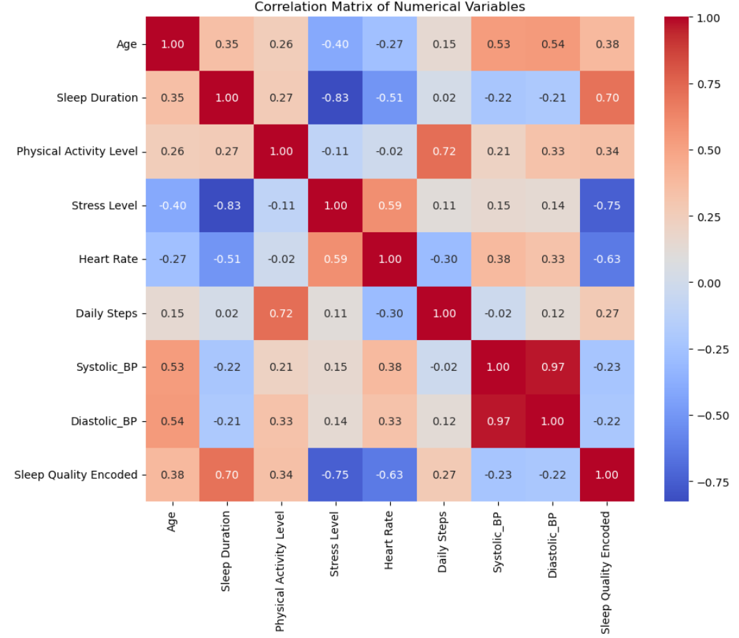
Correlation Analysis
Sleep Duration had the strongest positive correlation with Sleep Quality Encoded (0.70), indicating that longer sleep durations are associated with better sleep quality.
Physical Activity Level and Daily Steps showed moderate positive correlations (0.34 and 0.27), suggesting that higher activity levels contribute to improved sleep.
Stress Level had a strong negative correlation with sleep quality (-0.75), highlighting the adverse effects of increased stress on sleep.
Heart Rate exhibited a notable negative correlation (-0.63), implying that higher heart rates may be linked to poorer sleep outcomes.
Systolic_BP and Diastolic_BP showed weaker negative correlations with sleep quality (-0.23 and -0.22).

Slide 9
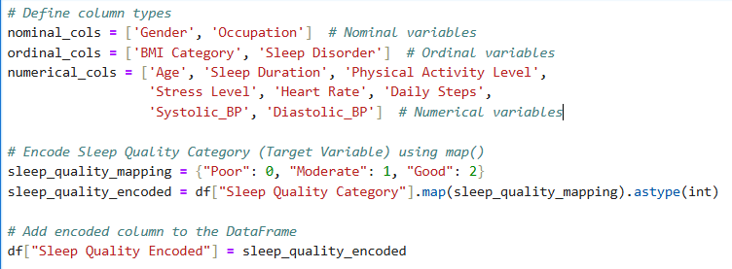
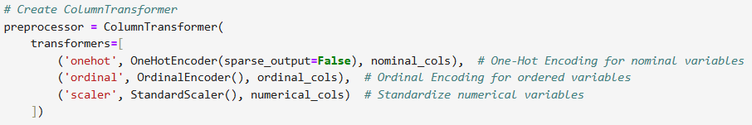
Encoding and Feature Transformation
Nominal Variables (Gender, Occupation): Encoded using One-Hot Encoding.
Ordinal Variables (BMI Category, Sleep Disorder): Encoded using Ordinal - Encoding to preserve natural order.
Numerical Variables (Age, Sleep Duration, Physical Activity Level, Heart Rate): Standardized using StandardScaler, ensuring all features have comparable scales and preventing model bias toward variables with larger numeric ranges.
-

Slide 10
Proposed Machine Learning Techniques
Random Forest: Best accuracy (97%), strong feature insights.
Neural Networks & XGBoost: Accuracy around 90-93%, good for non-linear relationships.
Support Vector Machines (SVM): Simple yet competitive (90-93%).
Challenges & Limitations
Data Reduction: Dataset significantly reduced post-cleaning.
Class Imbalance: Initial strong class imbalance affecting accuracy metrics.
Generalizability: Further validation needed on larger or external datasets.

